Slide 1
Committee To Kill
Hugo Boss
Working in an office. What a bore.
It’s only 3pm. Your mind wanders. Imagining what a more exciting workplace would be like, with action... with danger. The weight of existential dread momentarily alleviated by a life and death situation.
“Where did you file the Sorensen account?”
You are pulled from your daydream by a mundane request. Nothing you do here will ever matter. Inevitably it will all disappear in the annals of history...
3:05. Less than two hours to go...

Slide 2
Hugo Boss
Project manager at Power Industries
In every relationship there is a dominant, and a subordinate. This doesn’t apply to just the bedroom, but in business too. You are attracted to power; sometimes you want wield it over others. Other times you want to feel it suffocating you from above. Nothing is sexier than the rich and powerful whipping you senseless. Beatrice and Reece, two successful and wealthy individuals, recently invited you to a ‘play date’ where your custom made black leather gimp suit got a real workout. God you can’t stop daydreaming about that night… If only your wife was that adventurous...
Every morning you wink into the mirror at yourself. Written in chalk are the words ‘Sex and Money’; the two most important things in life. You get plenty of the former *flex* but not enough of the second. You blame Dominic Power your boss and CEO of Power Industries. The loser sends money that could be going to hard working and talented employees like yourself, to a charity named ‘We-Help-You’. Lame.
Speaking of not lame: You have three, count em’ three! Lamborghinis. They look slick, but you may have taken on a little debt… Luckily all that charity money Dominic is throwing away has been slowly making its way into a shell account… under HUGO BOSS. Boss move, even if you do say yourself. This was meant to be your little money making venture but Brad caught you in the act of counting the wads of cash you most recently withdrew from the account and you had to cut him in. What a slimy criminal.

Slide 3
You’ve hidden the cash in the server room until the office is empty and you can both go fetch it. It has been difficult until now because Leo keeps working late, and god knows you wont stay past 5:30, working long hours is for suckers. Maybe Leo is on to you? Either way he needs to keep his nose out of your business, time to become the Dom in yours and Leo’s workplace relationship...
Your Goals:
Protect the money. Either hold onto it yourself, or get Brad to grab it. If the bomb is defused, then keeping it hidden in the server room is also a valid option.
Get Leo fired. You are worried that your embezzlement scheme has been discovered by Leo. Better proactively get rid of him just in case.
Get Reece and Beatrice on board for round 2. That was hot.
Crowdsource the most believable excuse. Get others to suggest what excuse you'll feed your wife about where you were during the night of your ‘play date’.

Slide 4
Other People
Beatrice Pirozzi
You used to be her gimp. Good times. Why did it have to end?
Dylan Walsh
Your favourite (and only) building janitor. Dumb as bricks.
Dominic Power
You remain irritated that your salary was never increased to your liking.
Helen Roland
She’s isn’t too old for my tastes. I wonder if she knows how to use a whip.
Brad Scullin
Brilliant mind, and deserving of your special partnership.
Leo Fox
His youthful exuberance annoys you, and attracts your wrath. You worry he might know what you’re up to, hence the push to get him fired.
Sam Bayley
They’re crazy. Crazy hot!
Reece Remington
You found him mildly attractive in your youthful days. His age only makes him better.

Slide 5
Abilities
Use these to do things. They have a limited use, so check them off when you use them.
Have you seen my beach ball? *flex*
Ability
Show off your sexy musles to distract anyone into showing you their information.
Usages: O O O
Check out my sweet rides
Ability
You and another player reveal secrets to each other.
Usages: O O O
You! My office! Now!
Ability
Barge your way into a room, and demand that a player follows you away to a private location to hold a short private conversation with you. During this time, that player cannot use any abilities and cannot interact with anyone other than you.
Usages: O O O

Slide 6
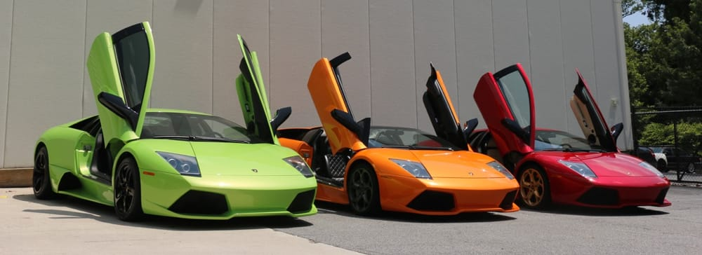
Secret and Information
Your Secret contains your guilty secret, while your Information contains one or more items of information you know. Both may be affected by abilities. Your lie may need to be filled out later.
While you can show your Secret and Information to whomever you like, you will probably not want to reveal your Secret too often. (Please note that you can’t solve the murder by looking at everyone’s Secret and Information – it’s not that easy!)
You own multiple lamborghinis *flex*.
Secret
Many employees at Power Industries complained that Dominic decided to donate huge amounts to charity instead of increasing their wages.
Info
Intentionally left blank.
You may be asked to write something in here by another player.
Lie

Slide 7
Rules
The Organiser’s Word is Law: The organisers are impartial. If you have a problem or want to do something unusual, see an organiser. The organiser’s power is absolute – and cannot be affected by ability cards!
Winning and Losing: You can achieve most of your goals simply by talking to people. The organisers will announce when the game is over. If you haven’t succeeded by that point – you’re too late! Be warned – not everyone here will want you to succeed!
Doing Stuff: Ordinary actions are resolved by simply carrying them out. If you want to try something unusual (such as trying to hack the pentagon), see an organiser. The organisers knows everything – and will be able to tell you the outcome of whatever it is that you are trying to do. (For example, you are trying to hack over state lines and you are caught.) Do use your imagination, though! – this is a very flexible game, and you can do all sorts of things beyond what’s listed in these rules.
Fighting: If an ability or item lets you hard another player, don’t just dive in! See the organisers first and tell them what you plan to do so they can oversee and give you more detailed rules if it’s necessary.
Fired: A fired player does not have their vote counted and must hand over all of their access cards.
Leaving: There is no escape until the elevators or stairs are ready.
Item Cards: Any items of importance within the game are represented as Item cards – and the only items that can affect the game are those detailed on the cards. If you do not have an Item card, you do not have that item with you.
Time: This game is played over three (ish) hours, including time for reading your character etc. There will be breaks throughout the evening! The organisers will tell you when each period starts and finishes.

Slide 8
Character List
Beatrice Pirozzi
Building owner of Pirozzi Tower, the very building you are in!
Carolina Feint
Building security guard, works for Beatrice.
Dylan Walsh
Building janitor, works for Beatrice.
Dominic Power
CEO of Power Industries.
Hugo Boss
Project Manager of Power Industries.
Helen Ronald
Human resources (HR) manager of Power Industries.
Brad Scullin
Senior financial consultant for Power Industries.
Leo Fox
Junior financial consultant for Power Industries.
Sam Bayley
Clerk for Power Industries.
Reece Remington
Entrepreneur, investor and client of Power Industries.

